Slide 1
The Science and Significance of Sunshine

Slide 2

Slide
Title: The Science and Significance of Sunshine

Slide 3

Introduction to Sunshine
Sunshine: Radiant light and heat from the Sun.
Crucial energy source for Earth.
Drives weather patterns and supports plant life.
Influences global climate.

Slide 4

Solar Energy Production
Nuclear fusion in the Sun's core.
Hydrogen converted to helium.
Immense energy released as electromagnetic radiation.

Slide 5

Electromagnetic Spectrum
Electromagnetic radiation includes visible light.
Also includes infrared (heat) and ultraviolet (UV) radiation.
Smaller amounts of radio waves, X-rays, and gamma rays.
Each has distinct wavelengths and energies.

Slide 6

Earth's Albedo
Sunshine reflected back into space.
Reflected by clouds, ice, and surfaces.
Earth's albedo regulates global temperature.

Slide 7

Solar Absorption
Sunshine absorbed by atmosphere, oceans, and land.
Warms components of the Earth system.
Drives evaporation, convection, and wind/ocean currents.

Slide 8

Photosynthesis
Plants convert light energy to chemical energy.
Sunshine directly supports photosynthesis.
Foundation of terrestrial and aquatic food webs.

Slide 9
Geographic Variations
Sunshine intensity varies geographically.
Due to latitude, altitude, cloud cover.
Seasonal changes in Earth's tilt and orbit.
Results in diverse climates and ecosystems.

Slide 10

Vitamin D Production
Sunshine vital for human health.
Stimulates vitamin D production in skin.
Essential for calcium absorption and bone health.
Supports immune system function.

Slide 11

UV Exposure Risks
Prolonged UV exposure can be harmful.
Causes sunburn and premature aging.
Increases risk of skin cancer.
Sun protection measures are important.

Slide 12

Applications of Sunshine Knowledge
Essential for solar energy generation.
Important in agriculture and climate modeling.
Crucial for public health initiatives.
Promotes vitamin D sufficiency and sun safety.

Slide 13

Solar Energy Technologies
Photovoltaic cells convert sunshine to electricity.
Concentrated solar power plants also used.
Renewable and sustainable energy alternative.

Slide 14

Angle of Incidence
Angle of incidence affects energy absorption.
Crucial for designing efficient solar panels.
Important for passive solar heating systems.

Slide 15

Agricultural Practices
Sunshine influences agricultural practices.
Affects crop growth cycles.
Determines irrigation needs.
Impacts planting and harvesting timing.

Slide 16

Studying Sunshine
Scientists use instruments and models.
Improves understanding of climate change.
Studies interactions with atmosphere and surface.

Slide 17

Ozone Layer Protection
Ozone layer absorbs harmful UV radiation.
Protects life on Earth from damaging effects.
Depletion due to human-made chemicals is a threat.

Slide 18

Atmospheric Scattering
Scattering by atmospheric particles creates blue sky.
Air molecules and aerosols are responsible.
Causes reddish hues during sunrise and sunset.

Slide 19

Photochemical Smog
Sunshine contributes to photochemical smog formation.
Sunlight interacts with pollutants.
Pollutants from vehicles and industrial sources.

Slide 20

Influence on Biomes
Sunshine influences climate and ecosystems.
Affects plant and animal life.
Leads to diverse biomes.
Ranges from rainforests to deserts.

Slide 21
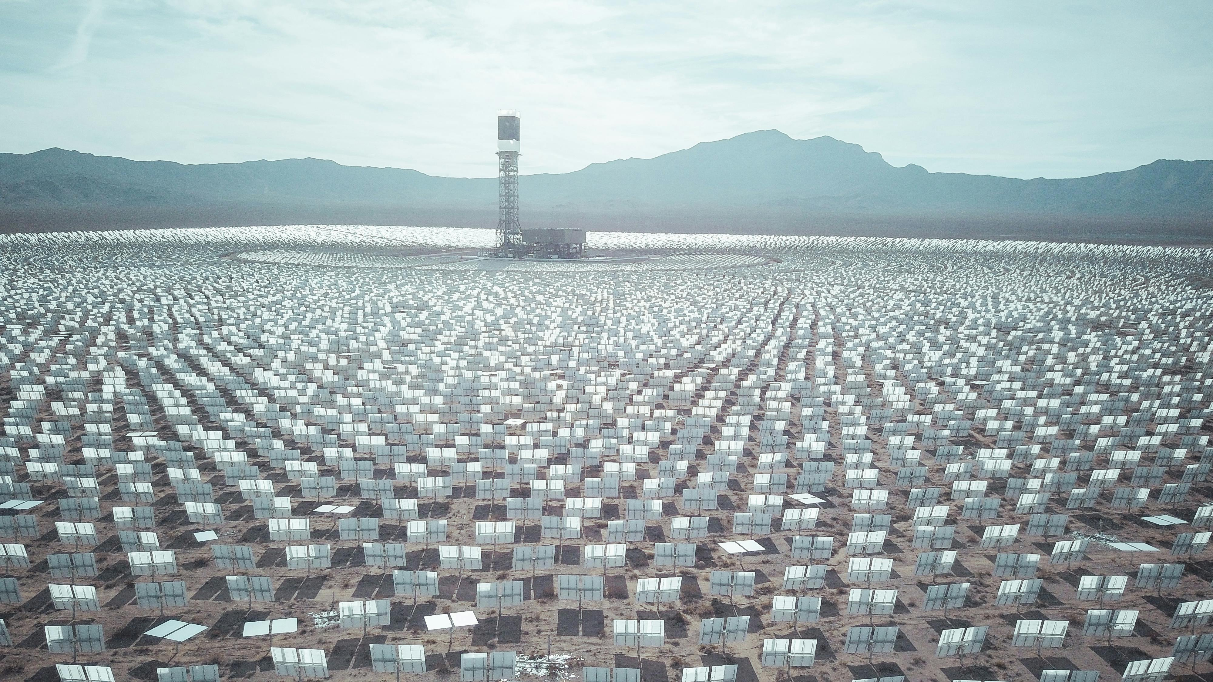
Sunshine Forecasting
Accurate forecasting is essential.
Optimizes solar energy production.
Manages agricultural resources.
Provides UV exposure risk warnings.

Slide 22
Conclusion
Sunshine: fundamental energy source.
Drives physical, biological, and chemical processes.
Critical for climate, health, and sustainability.
Understanding essential for addressing challenges.

